Slide 1
History of First Baptist Church Piney Grove Established 1904
Reverend Dr. Ezra L. Tillman Jr., Pastor

Slide 2
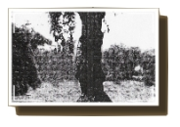
To this congregation belongs the distinction of being the city of Fort Lauderdale’s most unusual church. The church was organized under the name of Piney Grove Missionary Baptist Church in 1904, under the pastorate of the Reverend B.F. Goodwin of Lemon City, Florida. Eleven members comprised the congregation. They were Reverend Shelley, Brothers Jack Norris, Joe Robbins, C.S. Bryant, Joseph Lewis, John Bell, and James Bynum. Sisters Monie Bryant, Mary Bell, Mary Bynum, and Lucretia Jordan Jackson.
Sister Mary Bell named the church Piney Grove Missionary Baptist Church. It was located on the corner of Second Street and Brickell Avenue, under a bush arbor, which was south across the Florida East Coast Railroad.
Shortly after the church was established, a generous white gentleman, Mr. Thomas Bryant, gave permission to the members to use their schoolhouse to hold services. The building was located on the corner of Broward Boulevard and Third Avenue. Meetings were held in that building for only a few months. During that period, the membership increased. Some of the new members were Brothers James R. Williams, Mansel Calloway; Sisters Viola Stewart, Rachel Calloway, and Jennie Lee Bragdon.
After a number of years, the Reverend Thomas Allen was called to pastor, and it was under his leadership that C.S. Bryant was elected as chairman of the Deacon Board. The church bought Block 10 on Northwest Fourth Avenue. In 1911 the pastor and members disagreed and the church was sold. The members then purchased another lot on the corner of Second Street and Fourth Avenue, to find out later that they had built the church on the wrong lot. Within thirty days of that notice, the lot on which the church had been built was purchased. The church remained on that site until 1951.

Slide 3
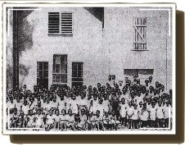
The next pastor called was the Reverend Welcome Baker. During his tenure he ordained Deacon James Lewis (the first deacon to be ordained in Piney Grove Missionary Baptist Church), J.R. Williams, and R.C. Williams. Sisters Monie Bryant, Viola Stewart, and Lucretia Jordan Jackson served as the first deaconesses. Sister Mary Bell was elected as the first clerk of the church. Others who served as church clerk during this period were Brother Cornelius Matthews and Sister Ella Wise.
After a number of years, the Reverend Baker took a leave and the next pastor called was the Reverend William Driver. He served for seven years. Under his administration, the edifice was enlarged, many members were added to the church, and an organ was purchased. The first organist was Sister Arnetha Dames.
Sister McDaniel of West Palm Beach, Florida organized the first Woman’s Home Mission Society. Sister Monie Bryant served as president. The First Baptist Young People’s Training Union (BYPU) was organized by Sister Janie Morris of Miami, Florida. Sister Viola Stewart served as president.
The Reverend A.H. Hamilton was called as the next pastor. However, he served for only a few months. After the departure of Reverend Hamilton, the Reverend W.W. Williams was called. He served faithfully for only a short time before he was called to rest from his labor.

Slide 4
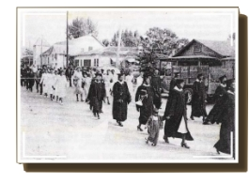
Looking to the Supreme Master, the church with undying faith was able to manage its business until the next pastor was called, the Reverend J.T. McCord. The Reverend McCord served three years and six months.
The church was without a pastor for eighteen months. It was during this time, under the leadership of Deacons Joseph Lewis, I.W. Williams, and Phil McNair that a church tower was built
The Reverend G. T. Green was the next pastor called. He served two years and was followed by the Reverend J. H. Brown, who served as pastor for a few months. This seemed to be the era of “short tenure” for pastors who served during this period of time. But with God’s help, the church continued to grow in membership regardless of the challenges we encountered.
In 1919, the Reverend T.M. Sapp was called and served faithfully until 1926. After the departure of Reverend Sapp, the Reverend Dinkins was called. The church began to grow rapidly. Many converts were baptized and trustees were appointed. Brothers Maynard Stephens and Harlan Williams were the first trustees.
The Reverend Stokes came to serve immediately after the departure of Reverend Dinkins. During Reverend Stokes’ pastorate, the mortgage on the church, in the amount of $551.00 was burned. Also, the parsonage was remodeled, an office was added, and stone steps were built onto the church.
After the departure of Reverend Stokes, the Reverend E. G. Thomas was called to pastor. He guided the flock for nine years and eight months. It was during this time that the Summer Vacation Bible School was organized.

Slide 5
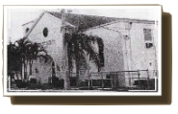
The Reverend Robert L. Holley was called as the pastor in 1941. During Reverend Holley’s tenure, the church site at 1100 Northwest Fourth Street was purchased, and the church was built at a cost of more than $90, 000. The church was dedicated in March 1951. The mortgage was burned in 1954. Credit goes to Reverend Holley, his devoted wife, Mrs. Susie C. Holley, and members for the building of the beautiful edifice.
Also, under the tenure of Reverend Holley, Choir No. 2 was organized in 1948. Choir No. 1 served for forty years as the only established adult choir that delivered spiritual messages through song to the church congregation.
Failing in health, Reverend Holley resigned in December 1955. As a demonstration of devotion and appreciation, the church retired Reverend Holley on a regular monthly honorarium as Pastor Emeritus.
In 1956, the Reverend J.W. Toomer was called. He came from St. Paul Baptist Church in Anderson, South Carolina. The most sorrowful loss during Reverend Toomer’s administration was the expiration of Pastor Emeritus Robert L. Holley in 1959.
Reverend Toomer served for ten years. Under his spiritual leadership and guidance, many accomplishments were realized. One such accomplishment was the initiation of the 8:00 AM Sunday morning worship service, which was specifically designed for members who worked on Sunday and wanted to have an opportunity to attend church. Other notable accomplishments were: the addition of a parking lot and a church office, the purchase and installation of a reverse cycle heating and air conditioning system, the purchase of new musical instruments, major kitchen renovations were made, and the parsonage mortgage was burned. During Reverend Toomer’s tenure, Mrs. Alzora R. Simmons served as church clerk.

Slide 6
In 1966, Reverend Toomer submitted his resignation. He was called to Shiloh Baptist Church in Orlando, Florida. On the eve of Reverend Toomer’s departure, a Pulpit Committee was officially appointed. The members of the committee were: Mrs. Marie Holloway, Mrs. Susie C. Holley, Mrs. Ernestine Turner, Brother Arthur Kennedy, and Deacon Floyd Colden, Chairman of the Board of Deacons. After the departure of Reverend Toomer, the church was under the leadership of the Reverend I.W. Mizell and the deacons for six months.
The Pulpit Committee searched diligently for a pastor. After the presentation of a number of ministers, the Reverend Cornelius Vanderbilt Ford was called from the Bethel Metropolitan Baptist Church in Saint Petersburg, Florida. Reverend Ford officially began his pastorate on February 26, 1967. The church made forward steps under his spiritual leadership.
In 1968, under Reverend Ford’s leadership, the church was incorporated and became known as First Baptist Church Piney Grove, Incorporated. During his administration, the Anthem Choir was organized, and later named in his honor, The C.V. Ford Anthem Choir. In 1978, the names of Choir No. 1 and Choir No. 2 were renamed The Gospel Choir and the Sanctuary Choir, respectively. The Music Committee was organized, and one of its observances was the “Annual Choir Day.” Nationally, the B.Y.P.U. was changed to B.T.U., therefore the B.Y.P.U. was re-structured under his administration. Mrs. Mercie L. Mims became church clerk during Reverend Ford’s tenure. Reverend Ford served faithfully for twelve years. He was called to rest from his labor on June 21, 1979.
Again, under the leadership of the Reverend I.W. Mizell and the deacons, the church continued to look to the Master with undying faith.

Slide 7
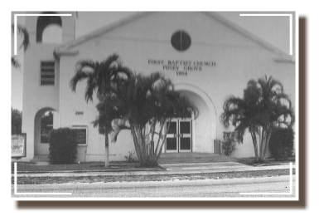
A Pulpit Committee was officially appointed to search for a pastor. Persons who served were Deacons Andrew DeGraffenreidt, Chairman of the Pulpit Committee; Josephus Eggelletion, Sr., Chairman of the Deacon Board; Sisters Marie Holloway, Susie C. Holley, Virginia Hansberry, Mary Levine and Bobbie Freeman; Brothers Rochelle Franklin, Richard Yeargin, Rodderick Gadson, and Meredith Singletary. On March 6, 1980, the church unanimously elected Reverend Samuel Milton Collier as pastor. Reverend Collier was installed as pastor on April 27, 1980.
Soon after Reverend Collier took the reins at First Baptist Church Piney Grove, Reverend Mizell was called from his labor on May 23, 1980. Under Reverend Collier’s leadership, the mortgage for the educational wing, which was added under Reverend Ford’s administration, was paid off. Wayne Robinson was hired as the first Minister of Music.
The Celestial Choir was organized and was referred to as “The Early Morning Choir.” A new organ was purchased. The Bus Ministry was initiated with the purchase of a van. This ministry was designed for those senior citizens (The Precious Gems) who needed a ride to church. It was also designed to keep the Precious Gems actively involved in church and community activities. The educational wing of the church was re-roofed. Additional Sunday School classes were added and a Prayer Breakfast was initiated. With prayer and togetherness as the basis of Reverend Collier’s program for the church, there was evidence of growth in membership and emphasis on watch-care (visiting the sick and shut-in and caring for their needs). It was under his leadership that we joined the county’s Meals-on-Wheels Program. Mrs. Mercie L. Mims continued to serve as Church Clerk under Reverend Collier through 1984. Prior to Reverend Collier’s departure, Mrs. Virginia T. Hansberry Moore became the Church Clerk. Reverend Collier resigned from the church in June 1985.

Slide 8
The church was without a pastor for approximately three years with Reverend Elmer R. Shell serving as the Interim Pastor. Again, a Pulpit Search Committee was appointed with the following members: Deacon Carl Crawford, Chairman and Deacon Charles McLymont; Sisters Margie Dallas and Lucy Lamar, Brothers Nathaniel Hankerson, Franklin Johnson, Bennie Levine, Harold Minnis and Bob Young. Sister Constance Staten provided the committee with efficient clerical assistance.
In the 83rd year of First Baptist Church Piney Grove’s history on February 1, 1987, Reverend Alfred L. Pugh became our Pastor. He and his wife, Cleora Pugh joined our Church Family. Under Reverend Pugh’s administration, numerous accomplishments were realized. First Baptist Church hired its first full-time Minister of Christian Education and Youth: Reverend Rufus M. Mosby. A module was acquired and used for Reverend Mosby’s ministries. Adoption of a church-wide plan for Christian Stewardship and a medical clinic in Bourg Champagne, Haiti in cooperation with Canaan Baptist Church of Philadelphia, Pennsylvania were some of his accomplishments. During his administration, he proposed and it was approved, the re-organization of the existing music program (the choirs). The choirs were re-structured as Mass Choir, Adult Choir, Brotherhood Choir, Youth Choir and Junior Choir, which was later named the Black/Tunnage Junior Choir in honor of its former musician and director of many years, Mrs. Emma Black and Mrs. Royetta Tunnage. On the first Sunday in October 1994, Reverend Pugh retired after seven years of service.
During the absence of a Pastor, the Church once again elected Reverend Elmer Shell as Interim Pastor and a Pulpit Search Committee was appointed with the following members: Deacon Arnold Tolbert, Chairman; Deacon Ashley Robinson, Deaconess Eddie Pearl DeGraffenreidt, Sisters Geraldine Thomas, Ernestine Turner, and Joi Bradley; Brothers Roosevelt Davis, Richard Black, and Bobby Bolden. Reverend Joseph L. Roberts, our 19th Pastor was called. He came to us on November 12, 1995 and was officially installed on Saturday, February 17, 1996. On January 23, 1996, Reverend Rufus Mosby was called to rest from his labor. During these 92 years, First Baptist Church Piney Grove had been supremely blessed.

Slide 9
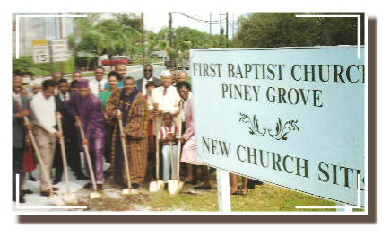
Since the year 1995, First Baptist Church Piney Grove’s history continued on the rise with Reverend Joseph L. Roberts, as Pastor, and his lovely wife Mrs. Jaris Roberts. Deacon Arnold Tolbert served as Chairman of the Board of Deacons. Under Pastor Roberts’ administration, numerous accomplishments, improvements, and financial achievements were made. A few among the many are: The church budget doubled and its membership grew considerably. The Human Services Corporation was established for community improvement.
A drug rehabilitation program was started, an after-school tutoring program for school age children was initiated by Deaconess Emma Black and assisted by Dr. Dorothy Cook. A new computer system was purchased to meet the standard of demand, AIDS Ministry was started, Bible Study and Noon Day prayer service on Wednesdays were reinstated, started Bended-Knee Prayer Ministry, hired a full-time Administrative Assistant, hired the first full-time Assistant Pastor, Reverend Robert L. Perry, hired a full-time Minister of Music and a drummer, revitalized the feeding and clothing ministry, joined the SHARE program, paid off the mortgage on the parsonage, formed a relationship with United Way, HRS, Juvenile Justice System, AIDS clinic and the Grandparents program. In 2004, Reverend Roberts established a year-long observance of the 100th Church Anniversary, including the erection of a monument at the site of our original church near the corner of Northwest Fourth Avenue and Second Street in Fort Lauderdale. That site has been designated as an historic landmark by the City of Fort Lauderdale and the Fort Lauderdale Historical Society because First Baptist Church Piney Grove is the oldest Baptist Church in Fort Lauderdale. Also, under Pastor Roberts’ leadership, 6.5 acres of land was purchased for a new church at 4699 West Oakland Park Boulevard. The construction of the edifice began in 2003 and was completed in 2005.

Slide 10
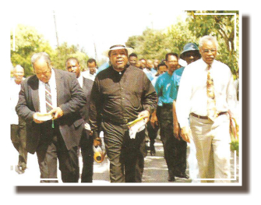
On April 9, 2005, Pastor Roberts led a motorcade on his motorcycle from the Northwest Fourth Street site to our new church in Lauderdale Lakes. Following the ribbon cutting, all members, friends, and the community were invited to tour the new church. Through Pastor Roberts’ efforts, all persons attending received souvenir bottles of water with the church’s logo.
The month of May proved to be a busy month as First Baptist Church Piney Grove presented a “Musical Extravaganza” planned by Pastor Roberts. The Church Dedication was held on May 22, 2005. The building mission was complete and the ministry was about to move in a new direction. Many new members began to join the church and Pastor Roberts was ready with the restructured New Members Ministry to teach and prepare the new members for fellowship into the body of Christ.
The first year in the new structure declared the marvelous wonders of God as the church membership rose to over 2000. The Children’s Dance and the Health Care ministries were re-established; a children’s nursery was provided for parents or guardians to keep their children during church services; a new mini bus and a van were purchased; a playground was added and an automatic handicapped door mechanism was installed.
In 2002, after having served seventeen years as Church Clerk, Mrs. Virginia Hansberry-Moore retired. Having been the longest serving Church Clerk, she was awarded a Plaque of Appreciation for her many years of continuous commitment and service. Following Mrs. Moore’s retirement, Sister Mildred Hightower became the Church Clerk.
In 2005, Dr. Benjamin Stephenson collaborated with Ebenezer Baptist Church in Hallandale Beach, Florida to bring Success Camp to our church as its second site. Dr. Stephenson and Mrs. Kathy Turner worked tirelessly to lay the groundwork for launching the program. Dr. Eloise McCoy-Cain was invited to serve as the Program Director, and served in that capacity for three years under the auspices of Ebenezer Human Services, Inc. In 2009, Dr. Cain, along with the dedicated assistance of Mrs. Kathy Turner wrote a grant to continue the program for an additional four years. Success Camp at First Baptist Church Piney Grove has successfully operated as one of the church’s community service programs.

Slide 11
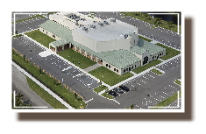
The year 2006 was a year of remembrance. On May 27th, under the guidance and direction of Sister Royetta Tunnage, we buried a time capsule and nearby, a South Florida Pine Tree was planted which is to serve as the landmark for locating the capsule in in the year 2031. As we continue to reflect on our past throughout the year, a monument was erected and dedicated at the historic site on the corner of Fourth Avenue and Second Street.
The year 2006 was a year of remembrance. On May 27th, under the guidance and direction of Sister Royetta Tunnage, we buried a time capsule and nearby, a South Florida Pine Tree was planted which is to serve as the landmark for locating the capsule in in the year 2031. As we continue to reflect on our past throughout the year, a monument was erected and dedicated at the historic site on the corner of Fourth Avenue and Second Street. The monument serves as a reminder of the many sacrifices, determination and continuous dedication offered toward the establishment and onward growth and progress of First Baptist Church Piney Grove. This year proved to be a year of firsts for we had our first formal fellowship dinner and our first fellowship cruise. Both were spearheaded by the Mortgage Reduction Ministry. We also had our first backyard cookout. Under Pastor Roberts’ leadership a new ministry was established for boys and young men, Iron Sharpens Iron.
On December 9, 2006, we laid a capsule in the cornerstone of the edifice. In biblical times, the cornerstone told you which direction the foundation would go and how high to build. Having been built on the foundation of the apostles and prophets, Jesus Christ himself being the first cornerstone in whom the whole building, being fitted together, grows into a holy temple of the Lord, in whom you also are being built together for a dwelling place of God in the Spirit.” Ephesians 2:20-23. Our cornerstone is laid in the chief cornerstone: Jesus. The following items were placed into the wall of the edifice: Bible, Hymn Book, and Pictorial Directories 2001 and 1996.

Slide 12
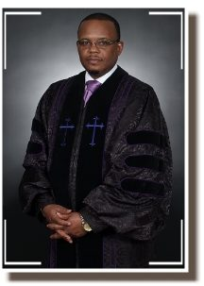
In June of 2008, Mr. Lennard Robinson, with the assistance of Ms. Gwendolyn Adams established the first Summer Camp. Ms. Brigitte Brihm served as the first Summer Camp Director. The camp was a 10-week program with an enrollment of fifty-seven campers, two teachers, two senior counselors and nine junior counselors. The curriculum included Bible Study, academic reinforcement, arts, crafts and field trips. The Summer Camp was a great success.
In August 2008, after twelve years of faithful service, Reverend Joseph Roberts retired as Senior Pastor. Our Assistant Pastor, Reverend Robert Perry was given the responsibility of shepherding our flock as Interim Pastor. A Search Committee was organized in order to select a new pastor. It was Reverend Perry’s prayer that First Baptist Church Piney Grove would become a full-service church.
On February 3, 2009, Deacon Donald Campbell, Chairman of the Deacon Board, convened the Pastor Search Committee to begin the process of searching for a new minister. He entrusted the Search Committee with the task of seeking the Holy Spirit’s guidance and direction in the process of leading First Baptist Church Piney Grove to accept the man that God would send to us.
Deacon Ernest Arterberry was elected Chairman of the Pastor Search Committee. Other members included Deaconess Veronica Phillips, Sister Gloria Warren, Deacon Jerry Covington, Deacon Stuart Pinnock, Trustee Dorothy Cook, Sister Ardra Davis, Sister Akilah Gibbs and Brother Tau Manigat Chatman.
The Pastor Search Committee reviewed over 160 resumes. Three pastors were invited to teach Bible Study, preach two sermons and meet and greet the congregation. On July 11, 2010, the congregation voted to call Reverend Dr. Derrick J. Hughes, Pastor of Springfield Baptist Church, of Memphis, Tennessee as our Pastor.

Slide 13
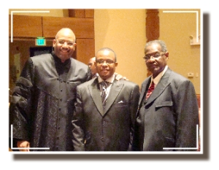
To introduce the Broward County Community to our new pastor, a reception was held in the First Baptist Church Piney Grove Holley/Mizell Fellowship Hall for Pastor Hughes. Guests included pastors, local city mayors, school board members, principals, assistant principals, local politicians and members of the community at large. It was a great coming together of community and pastor.
During the week of January 10, 2011, pre-installation worship services were held for Pastor Hughes. Guest Pastors preached inspiring sermons to welcome our new Pastor. On Wednesday, January 13th, the renowned gospel recording artist Smokie Norful blessed us with a soul stirring concert. On Friday January 15th, a banquet was held for Pastor Hughes and his wife, Mrs. Deborah Hughes at the Broward County Convention Center.
On Sunday, January 16, 2011, Reverend Hughes was officially installed as Pastor of the Historic First Baptist Church Piney Grove. His spiritual theme is “Building Churches, Empowering Communities and Impacting Nations.” The Vision Statement of the Church is: We will be a congregation of more than ten thousand members comprised of multiple ethnicities dedicated to making the principles of Jesus Christ the dominant influence of South Florida. Furthermore, we will carry the good news of Jesus Christ to domestic and foreign territories with the intent to minister to people’s holistic needs for the cause of Christ. We will use God’s resources to further establish the kingdom of God here on earth.

Slide 14
Pastor Hughes’ mandate was to win souls for Christ. During his tenure as Pastor, over 3,000 NEW SOULS were added to the body of Christ.
Under Pastor Hughes’ leadership, a specific focus was put on Children and Youth Services. It was his vision to make sure that all children were able to have an age-appropriate worship experience. Kingdom, the name given our to Children and Youth Ministries became fully functioning, newly renovated, print rich nursery that we call Noah’s Ark. Noah’s Ark is our nursery for all babies and toddlers. For ages 4-10, we offer “Disciple Town.” The curriculum being used teaches our children about Christ and how to develop a close relationship with Him at a young age. In addition to Disciple Town, a Teen Worship was created. Each Sunday at 11:00 a.m., teens aged 13-17 enjoy their own worship experience in the fellowship hall.
Pastor Hughes recognized that in order to draw others to Christ, it was necessary to create flexible worship services. Under his leadership, the Saturday night, one-hour worship experience was birthed. Additionally, in 2018, Pastor Hughes created a one-hour morning worship service. The 9:30 worship service began in April 2018 and continues to flourish.
Under Pastor Hughes’ spiritual guidance, participation in Bible Study, renamed W.O.W. (Worship on Wednesday) grew tremendously. Pastor Hughes recognized that for a church as large as Piney Grove to continue to grow in number, it needed to become smaller by connecting members to one another. Small groups were created to afford members an opportunity to fellowship, study, pray and learn together. Life Groups/Cell Groups were created in 2016.

Slide 15
After 12 years of faithful services Reverend Hughes announced his retirement to the church and congregants. A pulpit committee was officially appointed to search for a pastor.
Deacon Donald Cook, Chairperson of the Board of Deacons, convened the Pastor Search Committee to begin the process of searching for a new pastor, as outlined in the Church Constitution. The committee was obedient to the Holy Spirit in searching for a pastor who was anointed for such a time as this.
The Search Committee was comprised of the following: Deacon Stuart Pinnock (Chairperson), Deacon Don Campbell, Rev. John Williams, Dr. Dorothy Cook (Co-Chairperson), Deacon Malcom Black, Sister Emma Sampson, Brother Christopher Rush, Sister Jeanette Smith and Brother, A. J. Whitfield. In the absence of our Pastor and during the course of our search, our assistant pastor, Rev. Lawson Boddie, held the reign down and performed duties as needed.
The Committee reviewed resumes and interviewed over 116 eligible candidates. After ZOOM interviews were completed, the candidates were narrowed down to ten, and then three. The committee visited the home churches of the three finalists, and they were invited to come to FBCPG to teach Bible study, preach two sermons and meet/greet the congregation, the leadership, and various ministries.

Slide 16
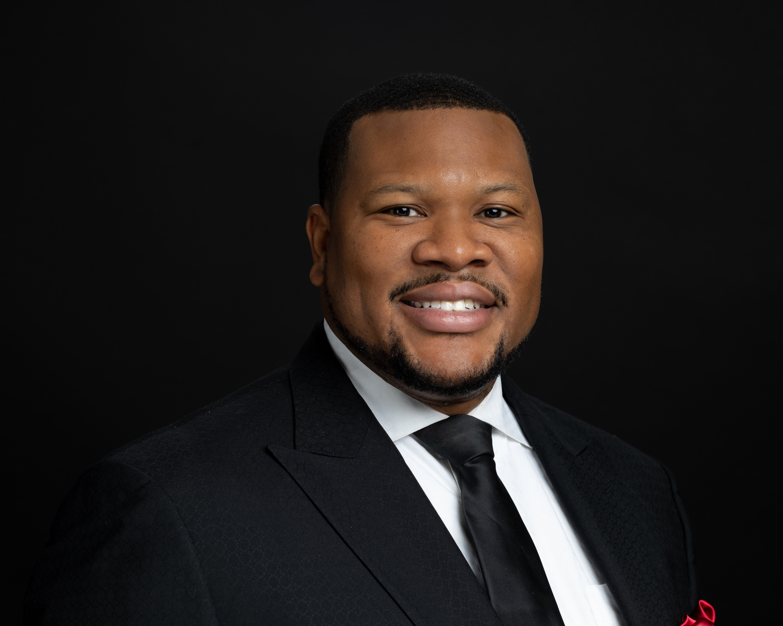
After continuous research, vetting and praying. Church elections were held and facilitated by the Broward County Elections Office. On March 26th 2023 the church voted unanimously for Dr. Ezra L. Tillman Jr.
On April 18, 2023 an official call letter was sent to Rev. Ezra L. Tillman, Jr., notifying him that he was elected as the 21st pastor of FBCPG. Dr. Ezra Tillman, his lovely wife, Lady Catrina Tillman and four sons were introduced and welcomed to the Church. Dr. Tillman’s Installation Service was held on Sunday, October 8th 2023, 4:00 p.m. (Installation Banquet @ Signature Grand – October 6th; Family Fun Day -October 7th)
Within Dr. Tillman’s first year of serving as Pastor, we have seen a tremendous growth in our membership. New ministries have been birthed such as the Women of C.L.A.S.S (Christian Ladies Appointed to Serve & Support) and the C.H.A.S.E Ministry (Connecting Hearts and Souls Effectively) developed to create a safe, spiritual led environment for youth with special needs that includes Christian education and development. Dr. Tillman also has a keen emphasis on Christian Education and Leadership. He has incorporated Deacons Lab and leadership training in addition to his Shepard Sessions taught to the congregation at large during the month of January.
Under Dr. Tillman’s leadership, he also launched the 700 Debt Free Campaign in efforts of First Baptist Church Piney Grove becoming a debt free congregation. Within six months, over $300,000 was raised by the membership of First Baptist Church Piney Grove resulting in the Burning of the Church Mortgage on May 15, 2024! To God be the Glory!
As we move forward, it is our prayer that God will continue to lead and guide Dr. Ezra Tillman Jr. as our Pastor, and fill him with wisdom and understanding so that he can feed us. It is our prayer that the will of God be manifested in our midst.

